Slide 1
BCube: A High Performance, Server-centric Network Architecture for Modular Data Centers
Chuanxiong Guo¹, Guohan Lu¹, Dan Li¹, Haitao Wu¹, Xuan Zhang², Yunfeng Shi³, Tian Chen⁴, Yongguang Zhang¹, Songwu Lu⁵
1: Microsoft Research Asia (MSR-A), 2: Tsinghua U, 3: PKU, 4: HUST, 5: UCLA
August 17, 2009
Barcelona Spain

Slide 2
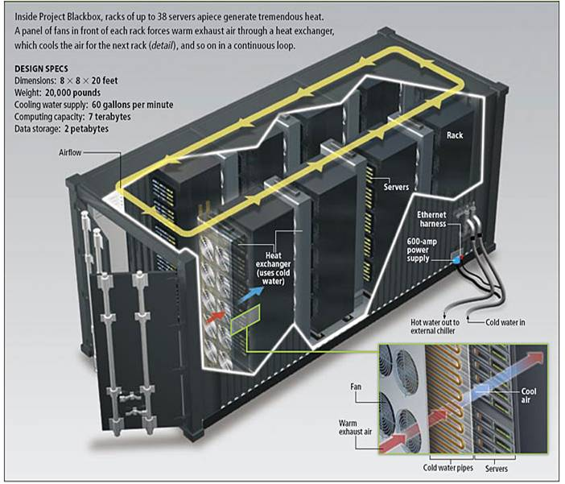
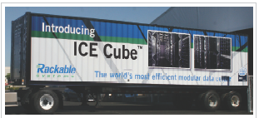
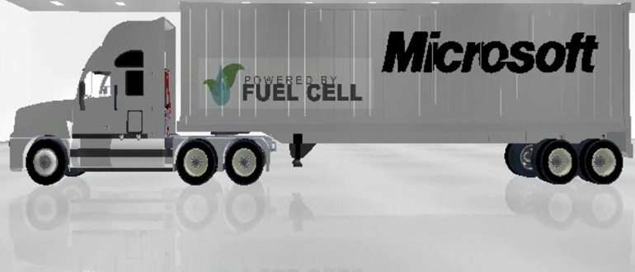
Container-based modular DC
1000-2000 servers in a single container
Sun Project Black Box
242 systems in 20’
Core benefits of Shipping Container DCs:
Easy deployment
High mobility
Just plug in power, network, & chilled water
Increased cooling efficiency
Manufacturing & H/W Admin. Savings
Rackable Systems Container
2800 servers in 40’

Slide 3
BCube design goals
High network capacity for various traffic patterns
One-to-one unicast
One-to-all and one-to-several reliable groupcast
All-to-all data shuffling
Only use low-end, commodity switches
Graceful performance degradation
Performance degrades gracefully as servers/switches failure increases

Slide 4
BCube structure
BCube1
<1,0>
A BCube_{k} network supports servers
n is the number of servers in a BCube₀
k is the level of that BCube
A server is assigned a BCube addr (a_{k},a_{k-1},…,a₀) where a_{i} ∈[0,k]
Neighboring server addresses differ in only one digit
<1,1>
<1,2>
<1,3>
Level-1
BCube0
<0,0>
<0,1>
<0,2>
<0,3>
Level-0
00
01
02
03
10
11
12
13
20
21
22
23
30
31
32
33
Connecting rule
The i-th server in the j-th BCube₀ connects to the j-th port of the i-th level-1 switch
switch
server

Slide 5
BCube: Server centric network
BCube1
Switch <1,3> MAC table
port
<1,0>
Server-centric BCube
Switches never connect to other switches and only act as L2 crossbars
Servers control routing, load balancing, fault-tolerance
<1,1>
<1,2>
<1,3>
MAC03
0
MAC13
1
MAC23
MAC03
MAC23
2
Switch <0,2> MAC table
MAC33
3
20
03
port
BCube0
MAC20
0
data
<0,0>
MAC21
1
<0,1>
<0,2>
<0,3>
MAC22
2
MAC23
3
MAC20
MAC23
20
03
00
01
02
10
11
12
20
data
03
13
21
22
23
30
31
32
33
dst
src
MAC addr
MAC23
MAC03
MAC20
MAC23
20
03
20
03
Bcube addr
data
data

Slide 6
Multi-paths for one-to-one traffic
Theorem 1. The diameter of a BCube_{k} is k+1
Theorem 3. There are k+1 parallel paths between any two servers in a BCubek
<1,0>
<1,1>
<1,2>
<1,3>
<0,0>
<0,1>
<0,2>
<0,3>
00
01
02
03
10
11
12
13
20
21
22
23
30
31
32
33

Slide 7
Speedup for one-to-several traffic
Theorem 4. Server A and a set of servers {di|di is A’s level-i neighbor} form an edge disjoint complete graph of diameter 2
<1,0>
<1,1>
<1,2>
<1,3>
<0,0>
<0,1>
<0,2>
<0,3>
00
01
02
03
10
11
12
13
20
21
22
23
30
31
32
33
P1
P1
P1
P2
P2
P2

Slide 8
Speedup for one-to-all traffic
Theorem 5. There are k+1 edge-disjoint spanning trees in a Bcube_{k}
src 00
01
02
03
10
11
12
13
The one-to-all and one-to-several SPTs can be implemented by TCP unicast to achieve reliability
20
21
22
23
30
31
32
33

Slide 9
Aggregate bottleneck throughput for all-to-all traffic
Aggregate bottleneck throughput (ABT) is the total number of flows times the throughput of the bottleneck flow under the all-to-all communication pattern
Theorem 6. The ABT for a BCube network is
where n is the switch port number and N is the total server number

Slide 10
BCube Source Routing (BSR)
Server-centric source routing
Source server decides the best path for a flow by probing a set of parallel paths
Source server adapts to network condition by re-probing periodically or due to failures
BSR design rationale
Network structural property
Scalability
Routing performance

Slide 11
Path compression and fast packet forwarding
Traditional address array needs 16 bytes:
Path(00,13) = {02,22,23,13}
Forwarding table of server 23
NHI | Output port | MAC
0:0 | 0 | Mac20
0:1 | 0 | Mac21
0:2 | 0 | Mac22
1:0 | 1 | Mac03
1:1 | 1 | Mac13
1:3 | 1 | Mac33
The Next Hop Index (NHI) Array needs 4 bytes:
Path(00,13)={0:2,1:2,0:3,1:1}
<1,0>
<1,1>
<1,2>
<1,3>
Fwd node
2 3
Next hop
1 3
<0,0>
<0,1>
<0,2>
<0,3>
00
01
02
03
10
11
12
13
20
21
22
23
30
31
32
33

Slide 12
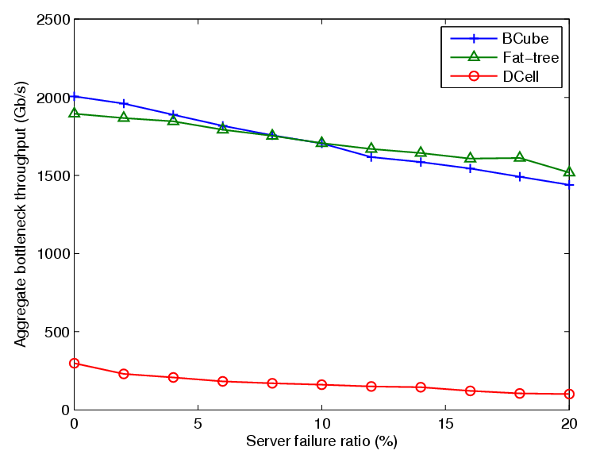
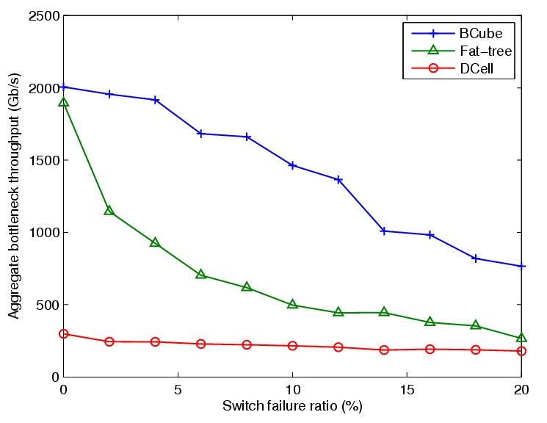
Graceful degradation
The metric: aggregation bottleneck throughput (ABT) under different server and switch failure rates
Server failure
Switch failure
BCube
BCube
Fat-tree
Fat-tree
DCell
DCell

Slide 13
Routing to external networks
Ethernet has two levels link rate hierarchy
1G for end hosts and 10G for uplink
aggregator
10G
<1,0>
<1,1>
<1,1>
<1,2>
<1,3>
<1,1>
<1,3>
1G
<0,0>
<0,1>
<0,2>
<0,3>
00
01
01
02
10
11
11
12
20
21
21
22
30
31
03
13
23
31
32
33
gateway
gateway
gateway
gateway

Slide 14
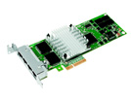
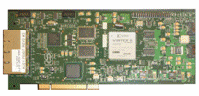
Implementation
BCube
configuration
app
software
TCP/IP protocol driver
kernel
Intermediate driver
BCube driver
Packet
send/recv
BSR path probing
& selection
Neighbor
maintenance
packet fwd
Ava_band
calculation
Flow-path cache
Intel® PRO/1000 PT Quad Port Server Adapter
Ethernet miniport driver
IF 0
IF 1
IF k
hardware
Neighbor
maintenance
packet fwd
server
ports
Ava_band
calculation
NetFPGA

Slide 15
Testbed
A BCube testbed
16 servers (Dell Precision 490 workstation with Intel 2.00GHz dualcore CPU, 4GB DRAM, 160GB disk)
8 8-port mini-switches (DLink 8-port Gigabit switch DGS-1008D)
NIC
Intel Pro/1000 PT quad-port Ethernet NIC
NetFPGA

Slide 16
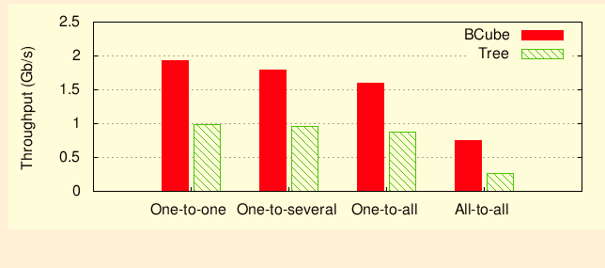
Bandwidth-intensive application support
Per-server throughput

Slide 17
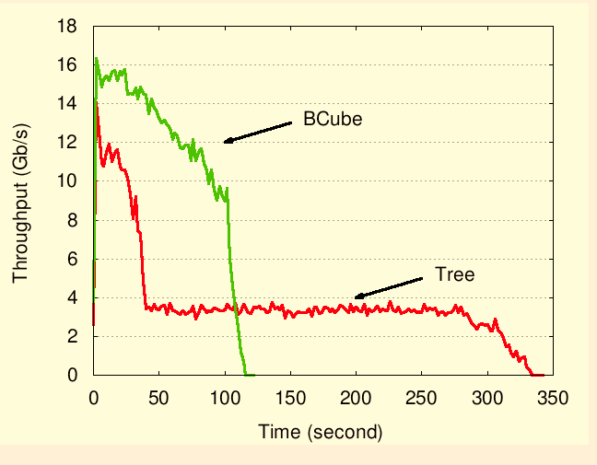
Support for all-to-all traffic
Total throughput for all-to-all

Slide 18
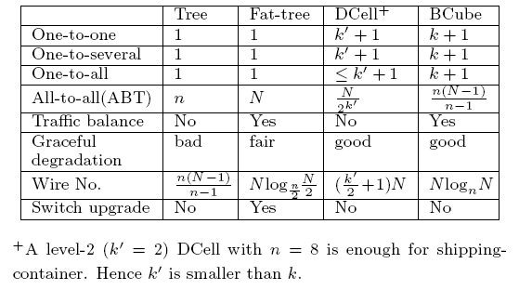
Related work
Speedup

Slide 19
Related work
UCSD08 and Portland
Rearrangeable non-blocking Clos network
No server change needed
Destination addr based routing
VL2
Reduces cables by using 10G Ethernet
Leveraging existing OSFP and ECMP
Randomized Valiant routing
DCell
For different purposes but share the same design philosophy
BCube provides better load-balancing and network capacity

Slide 20
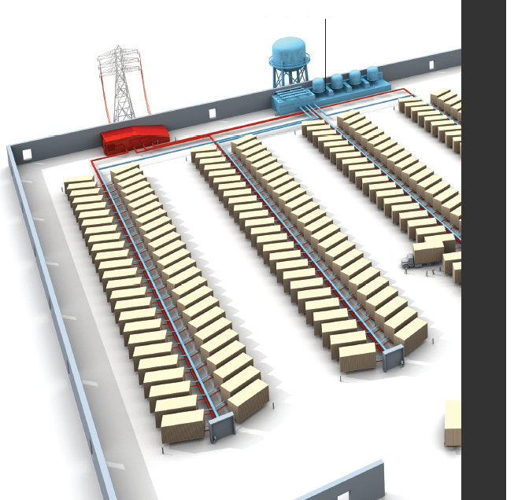
Summary
Internetworking for modular mega data centers
A novel network architecture for container-based, modular data centers
Enables speedup for one-to-x and x-to-one traffic
Provides high network capacity to all-to-all traffic
Purely constructed from low-end commodity switches
Graceful performance degradation
IEEE Spectrum Feb.

Slide 21
Q & A

