Slide 1

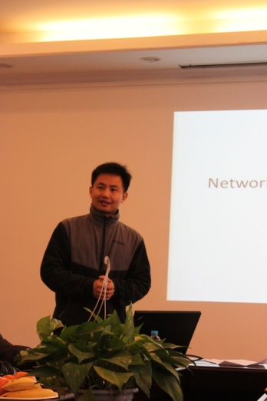
DCell: A Scalable and Fault Tolerant Network Structure for Data Centers
Chuanxiong Guo, Haitao Wu, Kun Tan,
Lei Shi, Yongguang Zhang, Songwu Lu
Wireless and Networking Group
Microsoft Research Asia
August 19, 2008, ACM SIGCOMM

Slide 2
Outline
DCN motivation
DCell
Routing in DCell
Simulation Results
Implementation and Experiments
Related work
Conclusion

Slide 3
Data Center Networking (DCN)
Ever increasing scale
  Google has 450,000 servers in 2006
  Microsoft doubles its number of servers in 14 months
  The expansion rate exceeds Moore’s Law
Network capacity: Bandwidth hungry data-centric applications
  Data shuffling in MapReduce/Dryad
  Data replication/re-replication in distributed file systems
  Index building in Search
Fault-tolerance: When data centers scale, failures become the norm
Cost: Using high-end switches/routers to scale up is costly

Slide 4

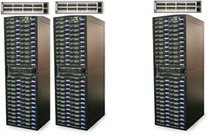
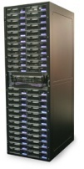
Interconnection Structure for Data Centers
Existing tree structure does not scale
Expensive high-end switches to scale up
Single point of failure and bandwidth bottleneck
  Experiences from real systems
?
Our answer: DCell

Slide 5
DCell Ideas
#1: Use mini-switches to scale out
#2: Leverage servers be part of the routing infrastructure
  Servers have multiple ports and need to forward packets
#3: Use recursion to scale and build complete graph to increase capacity

Slide 6
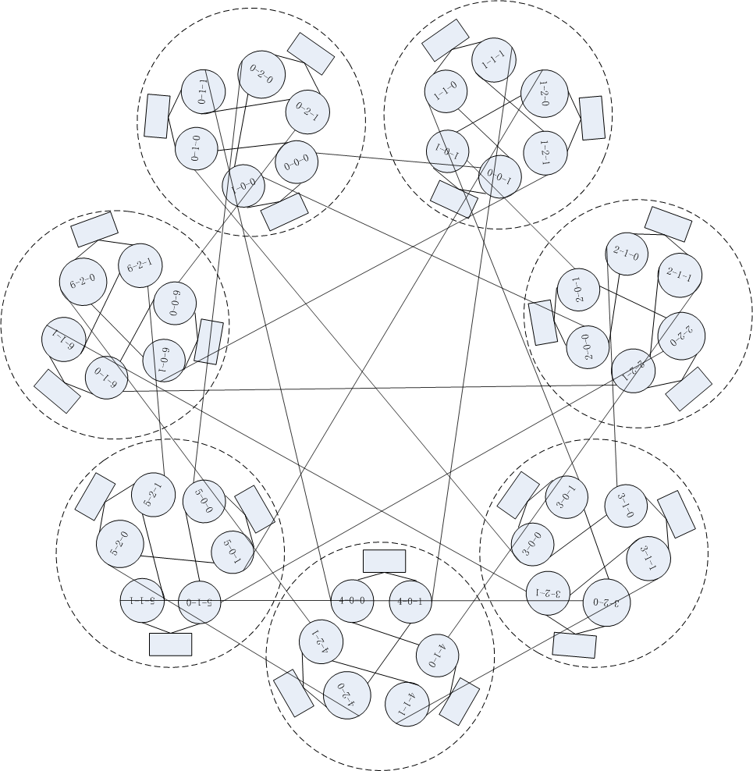
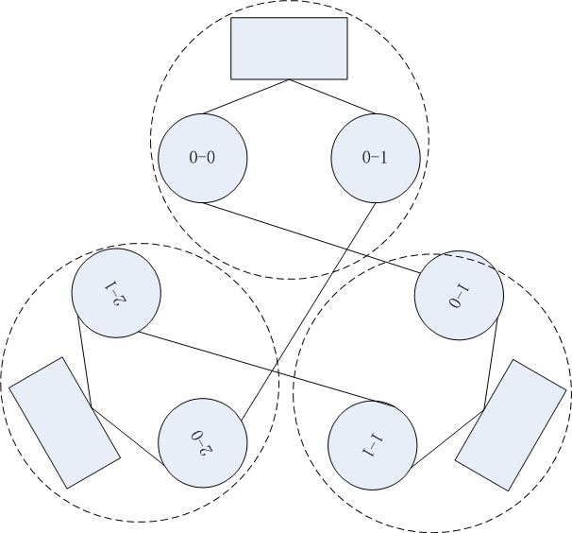
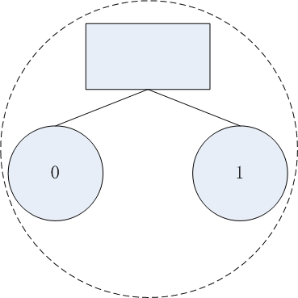
DCell: the Construction
Dcell_2
n=2, k=2
DCell_1
Dcell_0
Mini-switch
n=2, k=1
Server
n servers in a DCell_0
n=2, k=0

Slide 7
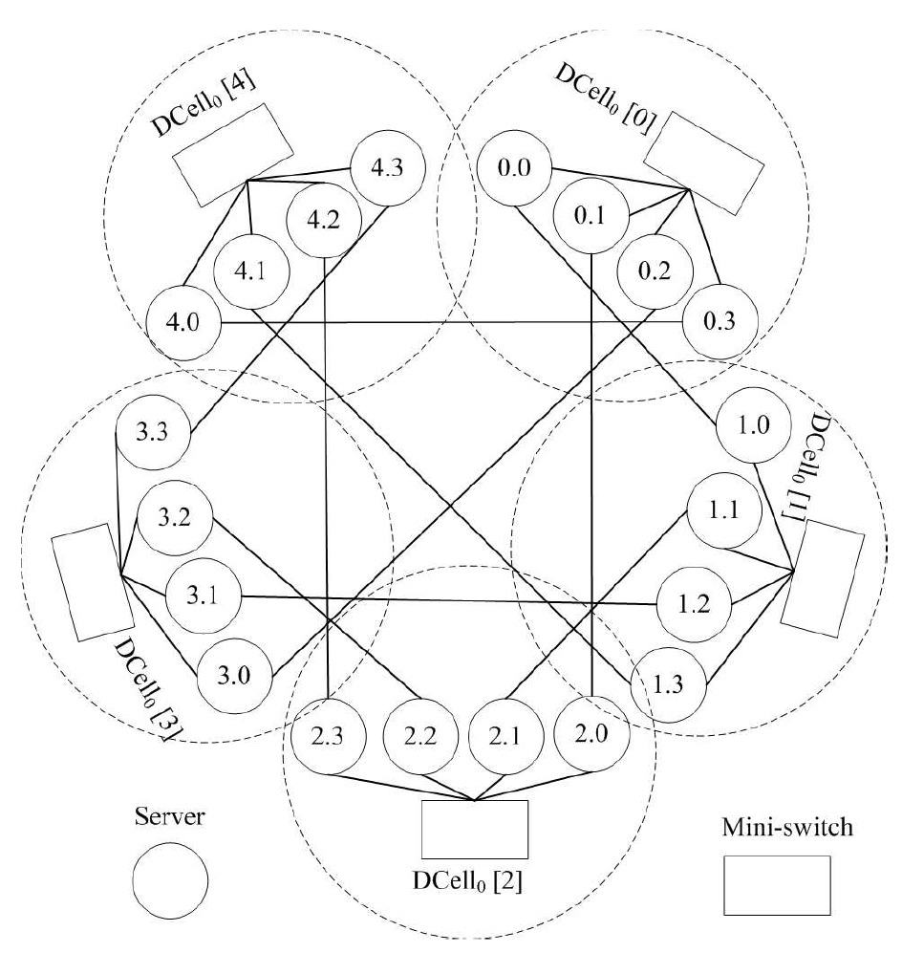
Another example
1) Dcell ₁ has 4+1 Dcell₀
2) Link [i,j-1] and [j,i] for every j> i
3) Dcell _{k} has t _{k-1}+1 Dcell_{k-1}
4) Dcell _{k} is a complete graph if Dcell_{k-1} is condensed as a virtue node

Slide 8
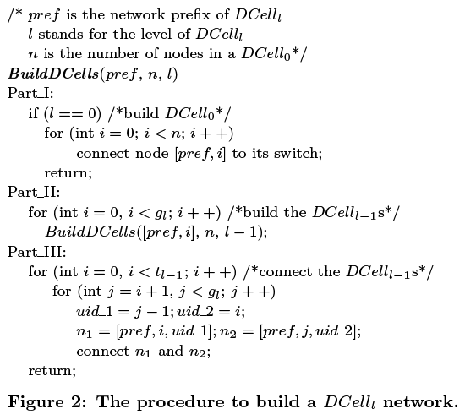
Recursive Construction
End recursion by building DCell0
Build sub-DCells
Connect sub-DCells to form complete graph
g_{l}:number of Dcell_{l-1}
T_{l-1}:number of servers in Dcell_{l-1}

Slide 9
DCell: The Properties
Scalability: The number of servers scales doubly exponentially
  Where number of servers in a DCell0 is 8 (n=8) and the number of server ports is 4 (i.e., k=3) -> N=27,630,792
Fault-tolerance: The bisection width is larger than
No severe bottleneck links:
  Under all-to-all traffic pattern, the number of flows in a level-i link is less than
  For tree, under all-to-all traffic pattern, the max number of flows in a link is in proportion to

Slide 10
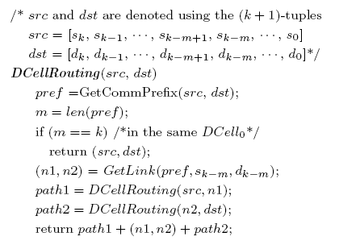
Routing without Failure: DCellRouting
src
n1
n2
dst
Time complexity:
2^{k+1} steps to get the whole path
k+1 to get the next hop

Slide 11
DCellRouting (cont.)
Network diameter: The maximum path length using DCellRouting in a DCellk is at most
But:
DCellRouting is NOT a shortest-path routing
is NOT a tight diameter bound for DCell
The mean and max path lengths of shortest-path and DCellRouting
n | k | N | Shortest-path |  | DCellRouting
 |  |  | Mean | Max | Mean | Max
4 | 2 | 420 | 4.87 | 7 | 5.16 | 7
5 | 2 | 930 | 5.22 | 7 | 5.50 | 7
6 | 2 | 1806 | 5.48 | 7 | 5.73 | 7
4 | 3 | 176,820 | 9.96 | 15 | 11.29 | 15
5 | 3 | 865,830 | 10.74 | 15 | 11.98 | 15
6 | 3 | 3,263,442 | 11.31 | 15 | 12.46 | 15
Yet:
DCellRouting is close to shortest-path routing
DCellRouting is much simpler: O(k) steps to decide the next hop

Slide 12
DFR: DCell Fault-tolerant Routing
Design goal: Support millions of servers
Advantages to take: DCellRouting and DCell topology
Ideas
  #1: Local-reroute and Proxy to bypass failed links
    Take advantage of the complete graph topology
  #2: Local Link-state
    To avoid loops with only local-reroute
  #3: Jump-up for rack failure
    To bypass a whole failed rack

Slide 13
DFR: DCell Fault-tolerant Routing
DCell_{b}
i₂
dst
DCell_{b}
src
L
n₂
r₁
i₁
n₁
m₂
m₁
q₂
p₁
Proxy
L
q₁
Proxy
p₂
L+1
s₂
s₁
Servers in a same
share local link-state
DCell_{b}
i₃

Slide 14
DFR Simulations: Server failure
Two DCells:
n=4, k=3 -> N=176,820
n=5, k=3 -> N=865,830

Slide 15
DFR Simulations: Rack failure
Two DCells:
n=4, k=3 -> N=176,820
n=5, k=3 -> N=865,830

Slide 16
DFR Simulations: Link failure
Two DCells:
n=4, k=3 -> N=176,820
n=5, k=3 -> N=865,830

Slide 17

Implementation
DCell Protocol Suite Design
  Apps only see TCP/IP
  Routing is in DCN (IP addr can be flat)
Software implementation
  A 2.5 layer approach
  Use CPU for packet forwarding
    Next: Offload packet forwarding to hardware
APP
TCP/IP
DCN (routing, forwarding, address mapping, )
Ethernet
Intel® PRO/1000 PT Quad Port Server Adapter

Slide 18
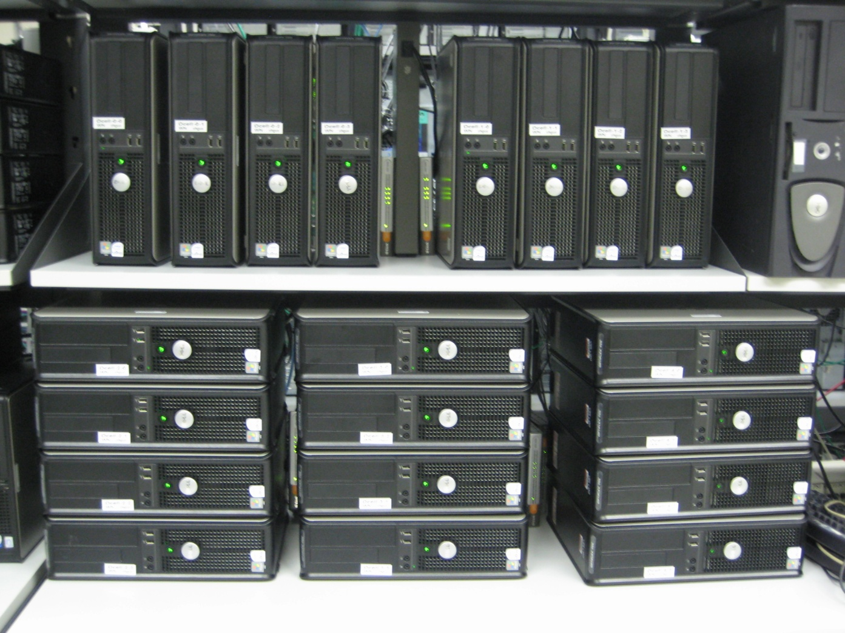
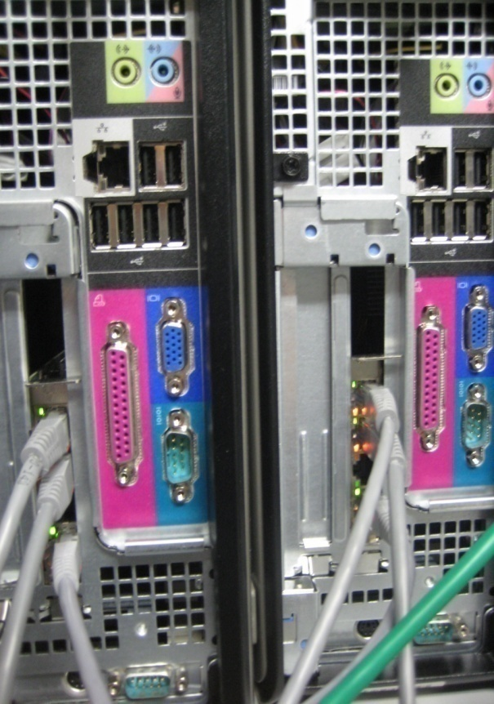
Testbed
DCell1: 20 servers, 5 DCell0s
DCell0: 4 servers
Ethernet wires
8-port mini-switches, 50$ each

Slide 19
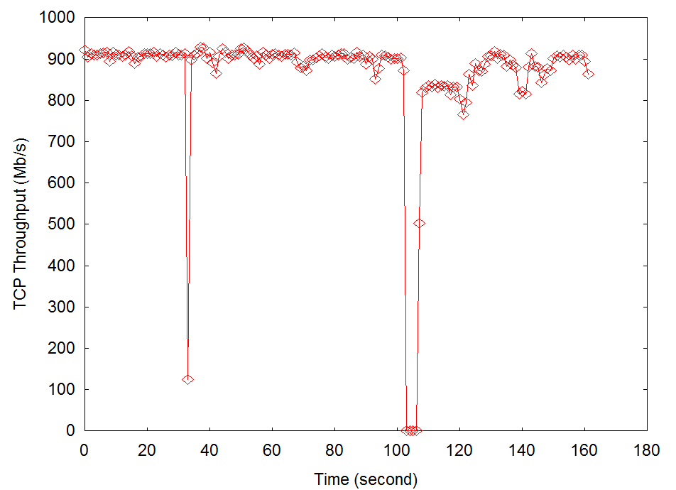
Fault Tolerance
DCell fault-tolerant routing can handle various failures
  Link failure
  Server/switch failure
  Rack failure
Link failure
Server shutdown

Slide 20
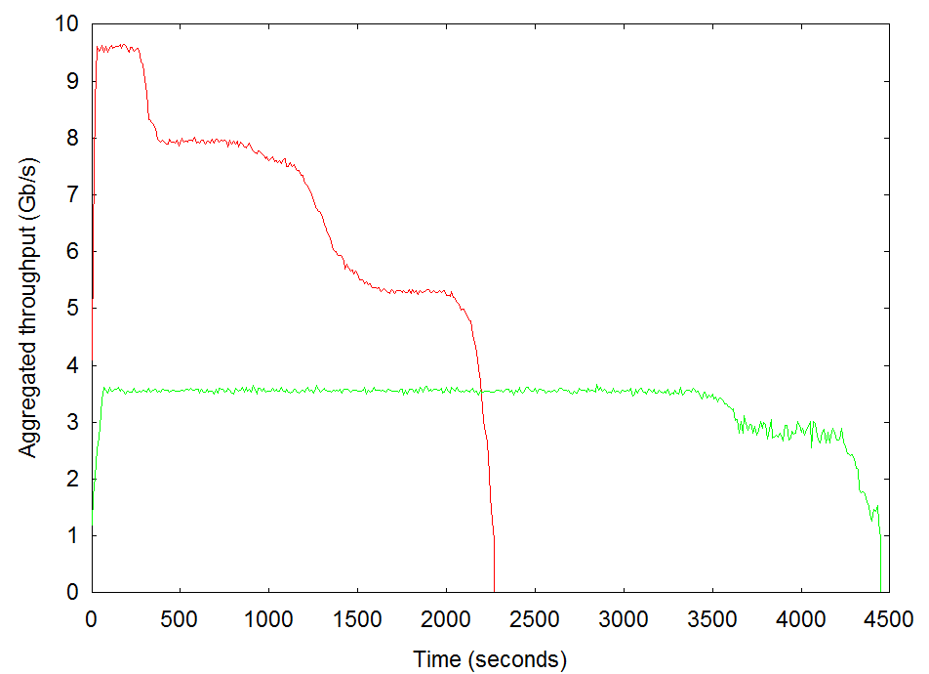
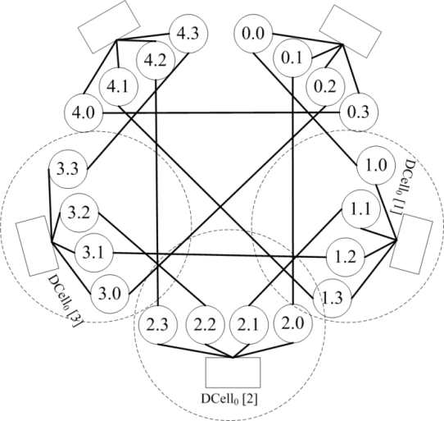
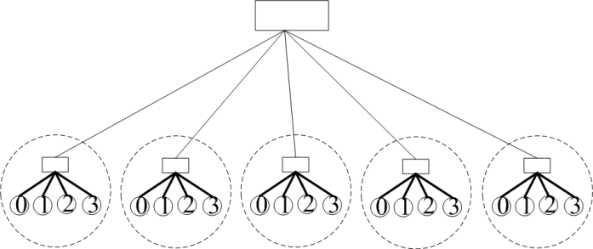
Network Capacity
All to all traffic: each server sends 5GB file to every other servers

Slide 21
Related Work
Hypercube: node degree is large
Butterfly and FatTree: scalability is not as fast as DCell
De Bruijn: cannot incrementally expand

Slide 22
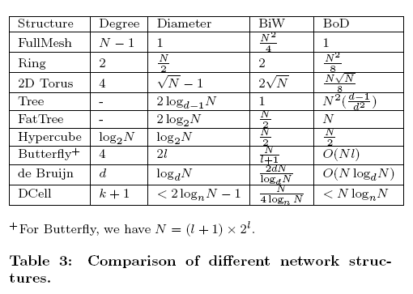
Related Work

Slide 23
Summary
DCell:
  Use commodity mini-switches to scale out
  Let (NIC of) servers be part of the routing infrastructure
  Use recursion to reduce the node degree and complete graph to increase network capacity
Benefits:
  Scales doubly exponentially
  High aggregate bandwidth capacity
  Fault tolerance
  Cost saving
Ongoing work: move packet forwarding into FPGA
Price to pay: higher wiring cost
Notes:
In summary, we have presented dcell, the fault-tolerant routing protocol on top of it, simulations and testbed experiments to demonstrates the performance of dcell.
One price to pay in DCell, as well as in other low dimensional structures, is much higher wiring cost.

