Slide 1
基于Solr的自动补全与提醒
517030910303 余兴梓

Slide 2
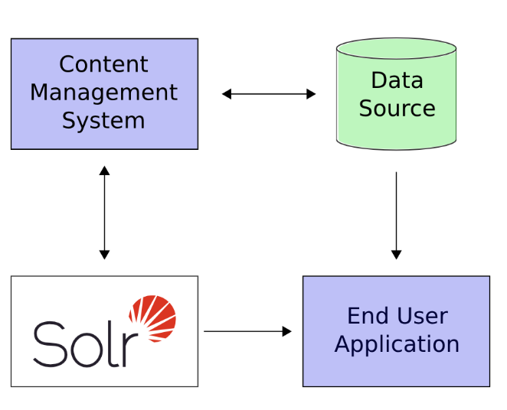
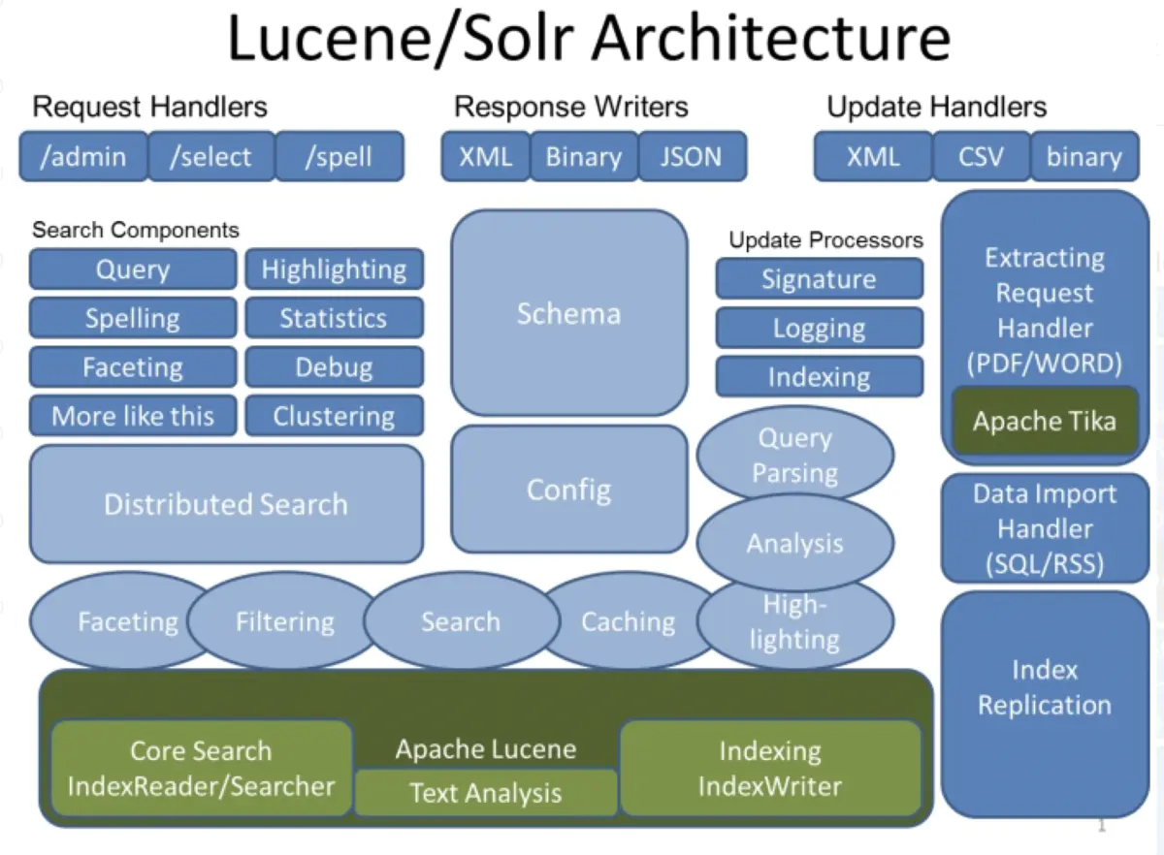
Background
Solr is a search server built on top of Apache Lucene, an open source, Java-based, information retrieval library
Solr runs alongside other server applications

Slide 3
Features
Full-text indexing and search
Based on open standards (XML, JSON and HTTP), it is highly extensible
Highly Scalable and Fault Tolerant
Flexible and Adaptable with easy configuration
……

Slide 4
Experiment Setup
Web framework: Django
Dataset: A small portion of Acemap database.
100,000 rows
Contains titles of papers
Solr version: 8.5.1
An overview of data

Slide 5
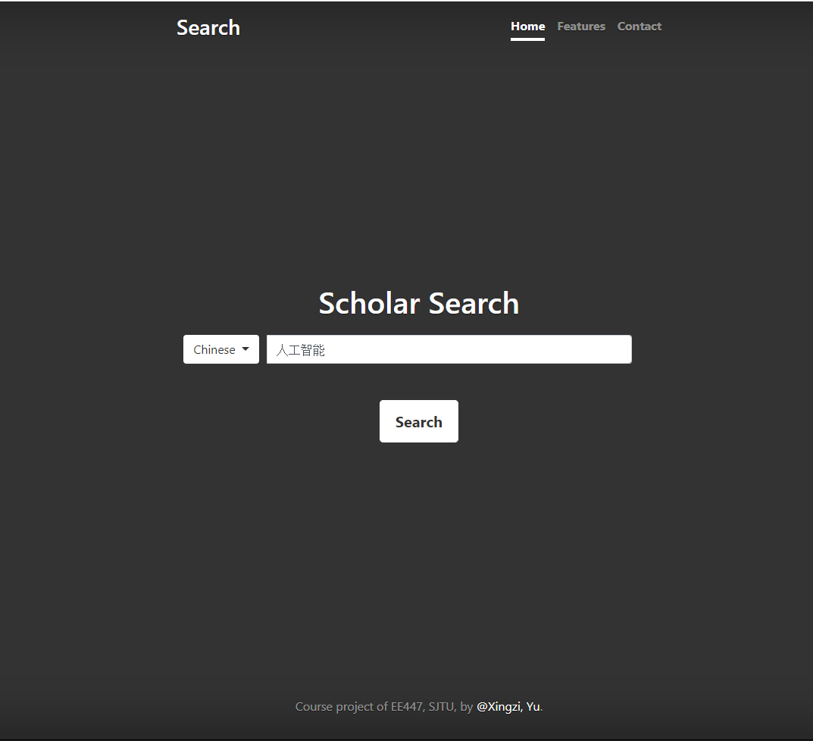
Website
English and Chinese are supported
Tokenizers are used
Can search by pinyin

Slide 6
Tokenizers & Filters
HMMChineseTokenizerFactory
PinyinTransform-
TokenFilterFactory
PinyinNGramTokenFilterFactory

Slide 7
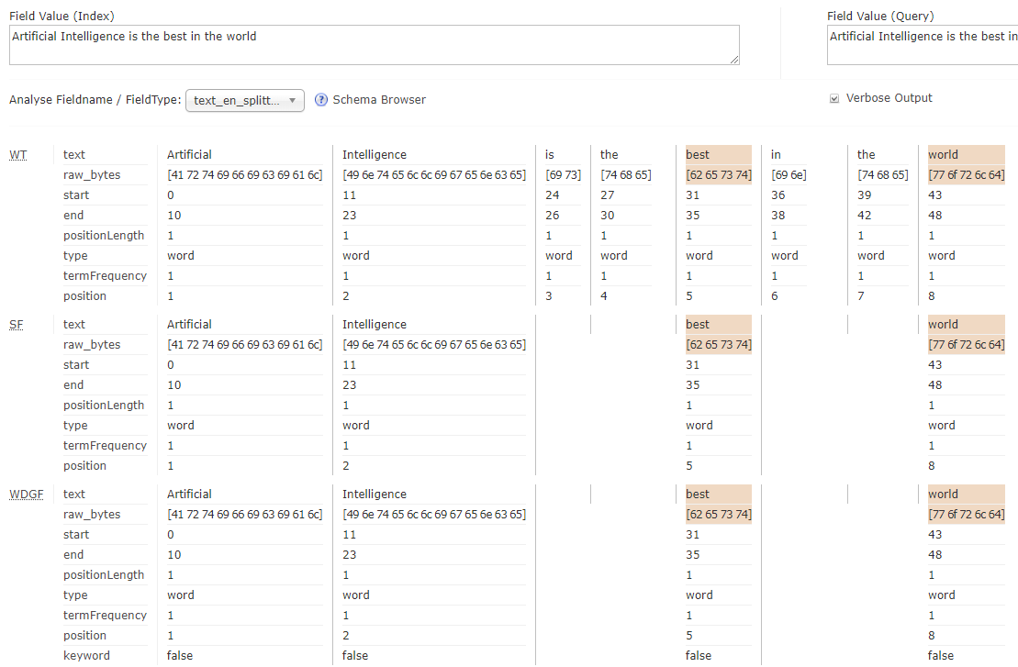
Tokenizers & Filters
WhitespaceTokenizer-Factory
StopFilterFactory
WordDelimiter- GraphFilterFactory
……

Slide 10
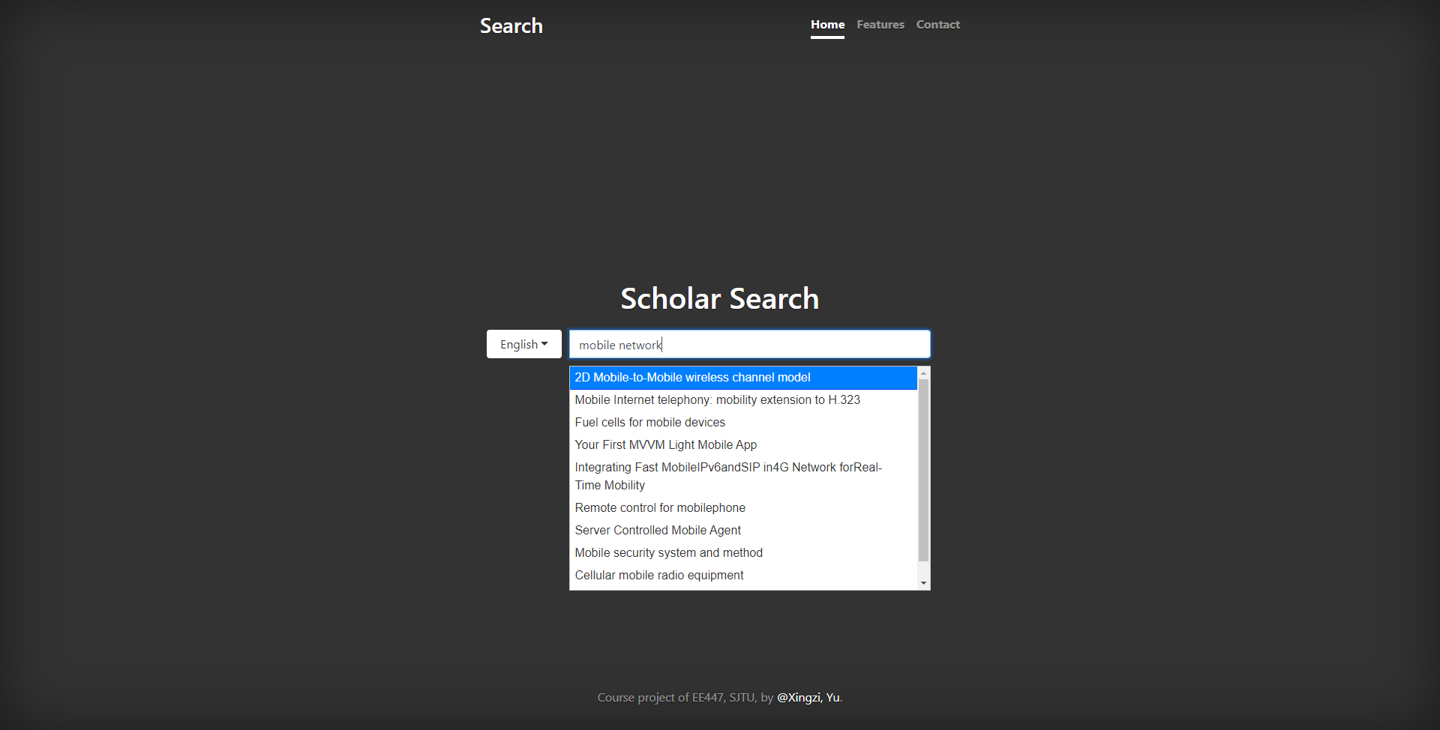

Slide 11
Future Work
Larger database, more rows and columns
Use facet and suggest in autocomplete and recommendation
Try SolrCloud
……

Slide 12
Thanks for Watching

