Slide 1
论文颜值分析
刘瀚文 杨晨宇 蓝宇霆 王孝诚
2020年5月

Slide 2
目录 Contents
1
Introduction
2
Data Processing
3
Model Description
4
Deployment

Slide 3
目录 Contents
1
Introduction
2
Data Processing
3
Model Description
4
Deployment

Slide 4
Problem Definition
Essay grading is a task to judge whether a paper is qualified based on what it looks like. It helps to reduce the reviewers' workload by excluding some terrible papers in advance.
For example, a good paper should contain:
No missing pages;
Figures、math expressions and proper tables;
well-formatted structure;
……

Slide 5
Two Methods
Text-based methods
Text-based Methods allow the model to leverage the paper's text to grade an essay. However, it does not take the rech visual information available in the paper into account and may be subject to bias toward popular keywords.
Vision-based methods
This method treat the whole paper as a picture for input. Then the model use some computer vision techniques (such as CNN) to evaluate the paper. By this way, pictures and tables, which are also important for a good paper, will not be ignored.

Slide 6
目录 Contents
1
Introduction
2
Data Processing
3
Model Description
4
Deployment

Slide 7
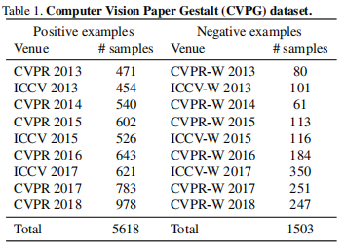
Preprocess
Computer Vision Paper Gestalt (CVPG) dataset consists papers from 2013 to 2018 in computer vision domain.
The provided dataset contains only pictures with text masked.
So we crawl the source PDF file
from http://openaccess.thecvf.com/menu.py

Slide 8
Ours
CVPG
2013-2017 for training and 2018 for test;
PDF files up to 12.2GB;
Papers in 2019 can be used to extend training samples if needed;
2013-2017 for training and 2018 for test;
Only pictures with text masked;
 | train | test
positive | 4641 | 979
negative | 1250 | 247
 | train | test
positive | 4640 | 978
negative | 1256 | 247

Slide 9
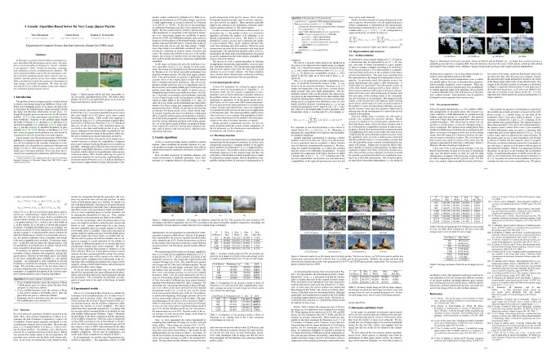
Preprocess
for CV:

Slide 10
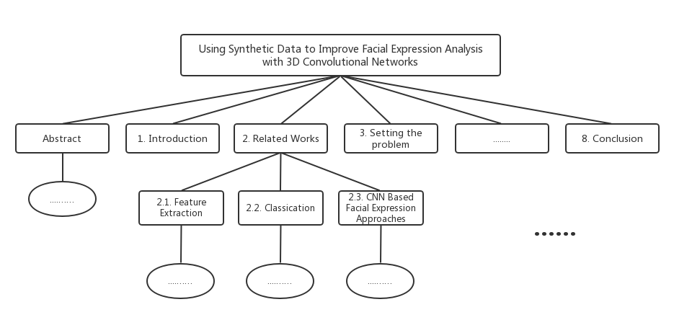
Preprocess
for NL:
Convert .PDF to .txt by pdfminer;
Process the text and extract structure information;

Slide 11
Preprocess
Limits:
Converting the pdf file to text will cause some noise. For example, the formula may not be correctly converted.
To handle this, we does not use the paragraphs and only leverage the subtitles.
In practice, a text version may be available. The result would be more accurate.

Slide 12
目录 Contents
1
Introduction
2
Data Processing
3
Model Description
4
Deployment

Slide 13
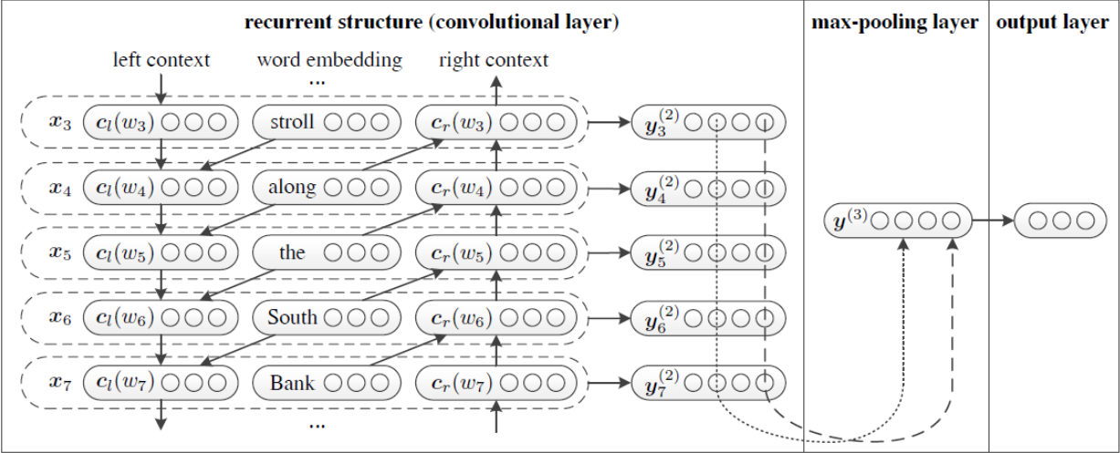
Text-based Methods(RCNN)
1) Use Bi-LSTM to obtain contextual information, similar to the language model.
2) Concancate the hidden layer output and word vector obtained by Bi-LSTM 3) Nonlinear mapping of the spliced vector to low-dimensional.
4) The value of each position in the vector takes the maximum value in all timings to obtain the final feature vector. This process is similar to max-pool.
5) Softmax classification.

Slide 14
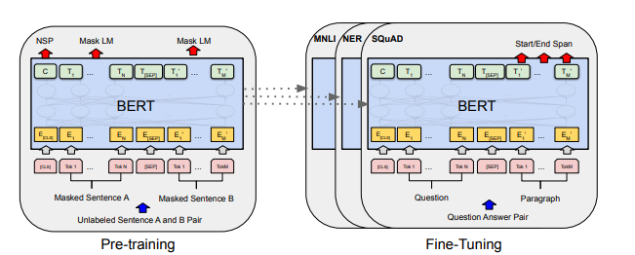
Text-based Methods(BERT)
BERT, Transformer's Bidirectional Encoder Representations from Transformers.
BERT performs joint adjustment based on the left and right contexts in all layers to pre-train deep bidirectional representations.
We add an output layer to fine-tune the pre-trained BERT representation to create the optimal model for our classification task.

Slide 15
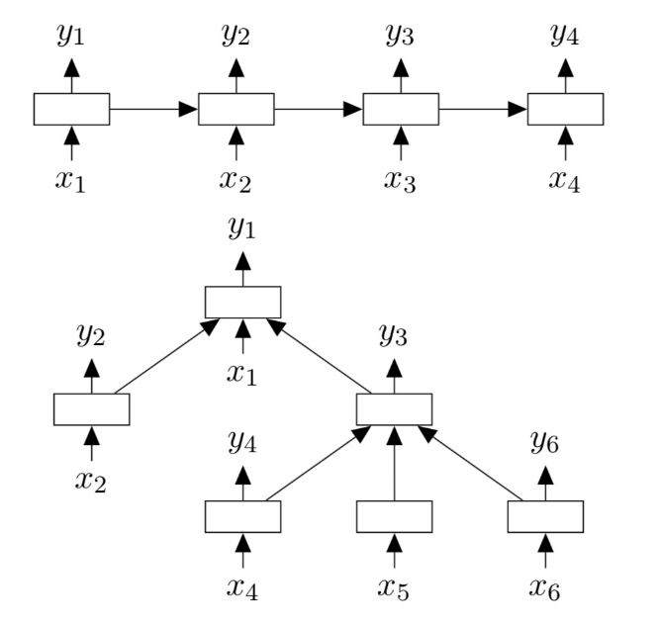
Text-based Methods(Treelstm)
Similar to the standard LSTM structure, each cell in the tree LSTM includes similar input gate, output gate, cell stat and hidden layer output. The difference is that the update of the gate vector and cell status in the Tree-LSTM cell depends on all The state of the related subunits. In addition, compared to the single forget gate of Standard LSTM, Tree-LSTM has multiple forget gates, corresponding to each subunit k of the current unit, which allows Tree-LSTM to selectively To obtain information, for example, to save the information of child nodes with richer semantic information in the sentiment analysis task.

Slide 16
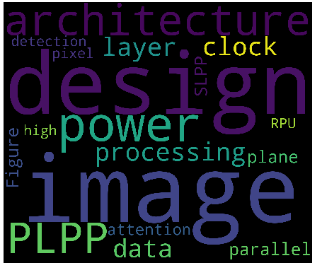
Text-based visualization
Word Cloud Word frequency analysis

Slide 17
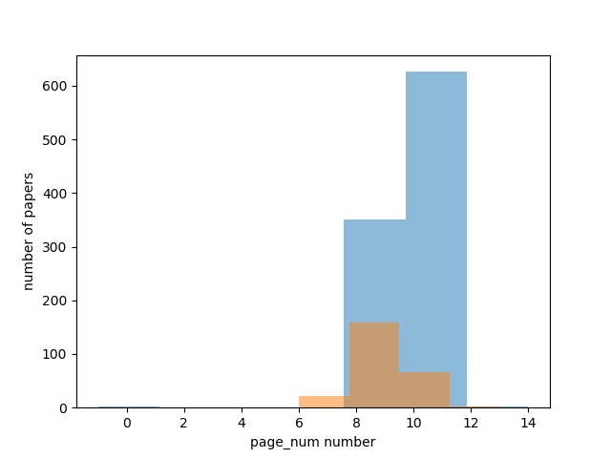
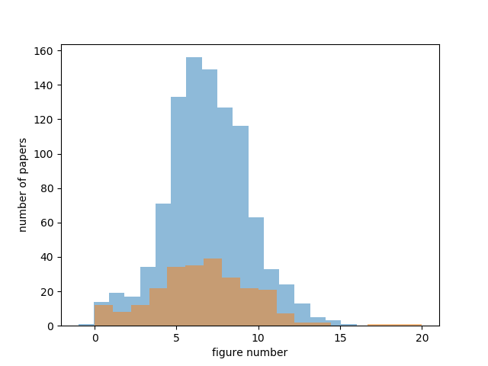
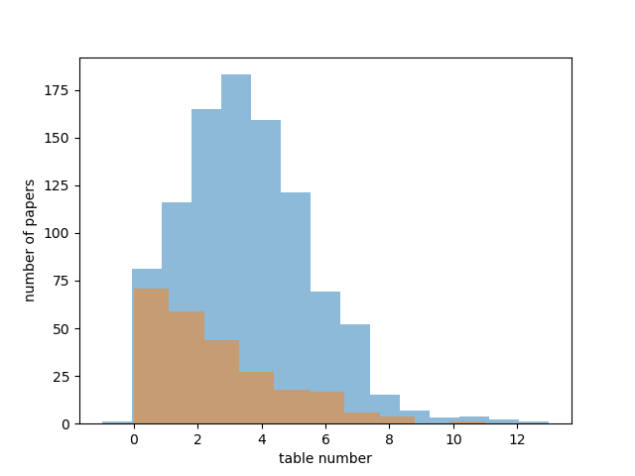
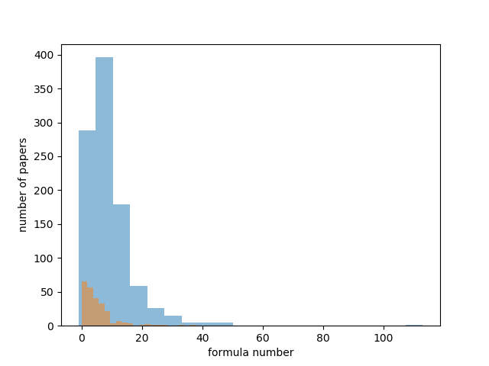
Vision-based Methods
What is gestalt.
完形（即有别于其内部个体单位、作为单一体系的一系列思想、经验等）
Figures, tables, mathematical expressions, number of pages
Notes:
asdqweqfssaf

Slide 18
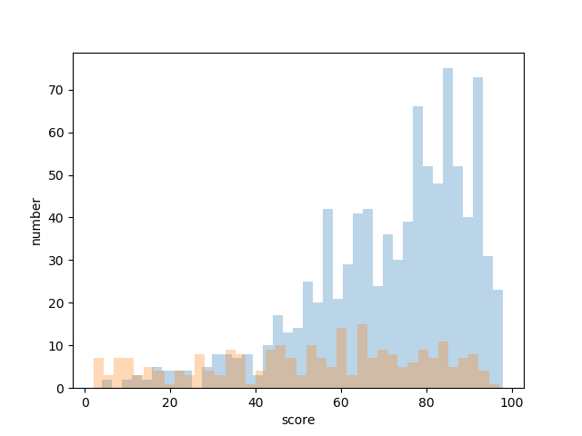
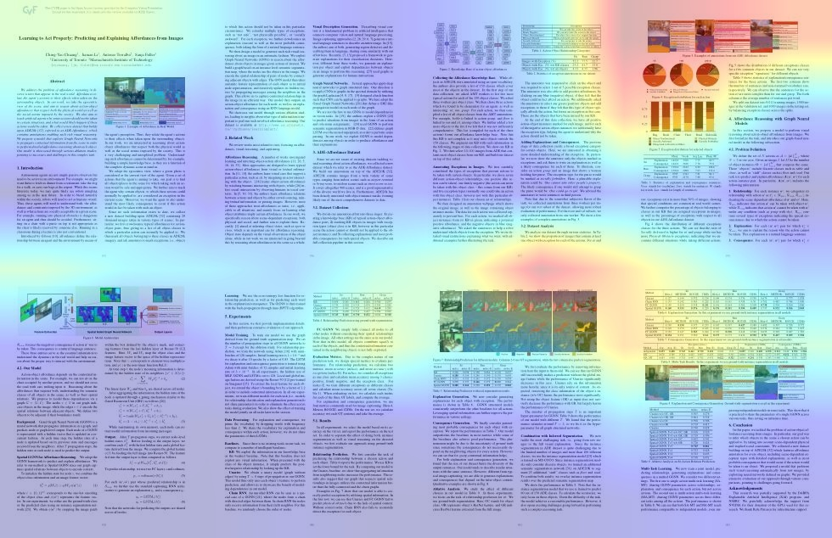
Choise of model
Recall | Good | Bad
VGG19 1GB | 97% | 27%
 | 84% | 55%
Densenet 53MB | 94% | 48%
 | 84% | 64%
Resnet18 80MB | 99% | 27%
 | 98% | 47%
 | 96% | 60%

Slide 19
Knowledge Distillation
train a student network from the softened output of an ensemble of wider networks as the teacher network
raise the temperature of the softmax until the teacher model produces a suitably soft targets, then use the same high temperature when training the small model
choose the middle layer of the teacher network

Slide 20
Page Based & Explicit Features
Different pages have different layouts, and contribute variously.
Score pages respectively, use these scores as features to train a new classifier.
Not much boost, but helps to generate heat map on the whole paper.
Extract amount of figures, math expressions and tables on each page to form a feature vector.
e.g. [[1,0,3],[2,4,1],[0,0,2],3]
VGG19 accuracy: 77%->86%

Slide 21
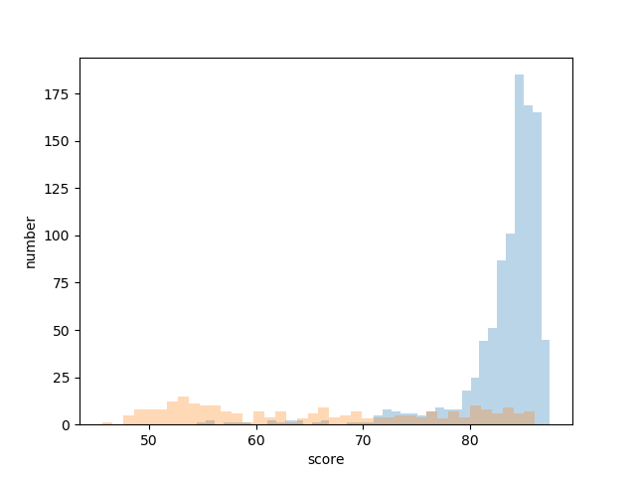
original
improved

Slide 22
目录 Contents
1
Introduction
2
Data Processing
3
Model description
4
Deployment

Slide 23
Deployment(including Integration)
AWS EC2 as our server
Flask based Back End
Drag and Drop Zone Front End
Automatically Process
Nginx Reverse Proxy

Slide 24
感谢！

