Slide 1
A Deep Reinforcement Learning Framework for Efficient Shared-Bike Scheduling
宋逸文
隆嘉轩

Slide 2
Basic Framework
Bike Use Prediction Network
Prediction ${\hat{u}}_{t+1}$
Deep Q Network
Spatial-Attention Layer
Temporal-Attention Layer
Decoder Layer
Q-Estimator
Policy-Generator
Action-Selector
Status of Stations $c_{t}$
Reward $r_{t}$
Environment
Scheduling at $t$
Need for bikes at each station: $u_{t}$

Slide 3
Dataset
Dataset from New York Open City (Capital Bike)
From Jan. 2019-Mar. 2020
586 bike stations, 492MB of data.
Duration | Start date | End date | Start station number | Start station | End station number | End station | Bike number | Member type
230 | 2019/1/1 0:04 | 2019/1/1 0:08 | 31203 | 14th & Rhode Island Ave NW | 31200 | Massachusetts Ave & Dupont Circle NW | E00141 | Member

Slide 4
Selecting Methods for Prediction
ARIMA
LSTM

Slide 5
ARIMA
Time Series Data
$$ARIMA\left(p, d, q\right)$$
Forecast Signal
$ARIMA\left(p, d, q\right)$ model:
$p$: # Autoregressive (AR) terms: Lags of the stationarized series.
$d$: # Nonseasonal differences.
$q$: # Moving-average (MA) terms: Lags of the forecast errors.
Objective: adjust $p, d, q$ until the residues are “white noise” (uncorrelated).
$${\hat{y}}_{t}=μ+φ_{1}y_{t−1}+…+φ_{p}y_{t−p}−θ_{1}e_{t−1}−…−θ_{q}e_{t−q}$$
Noise
(Residues)
Constant
(Usually 0)
AR Terms
MA Terms

Slide 6
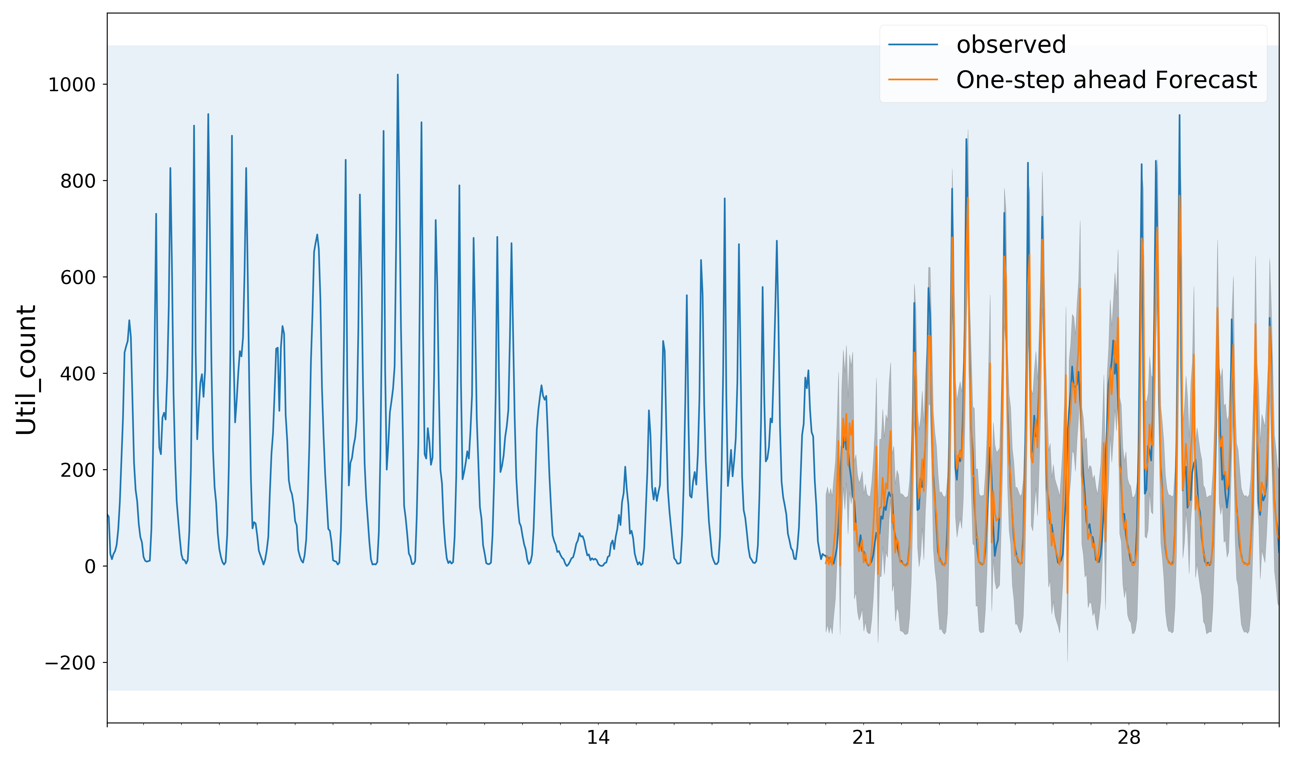
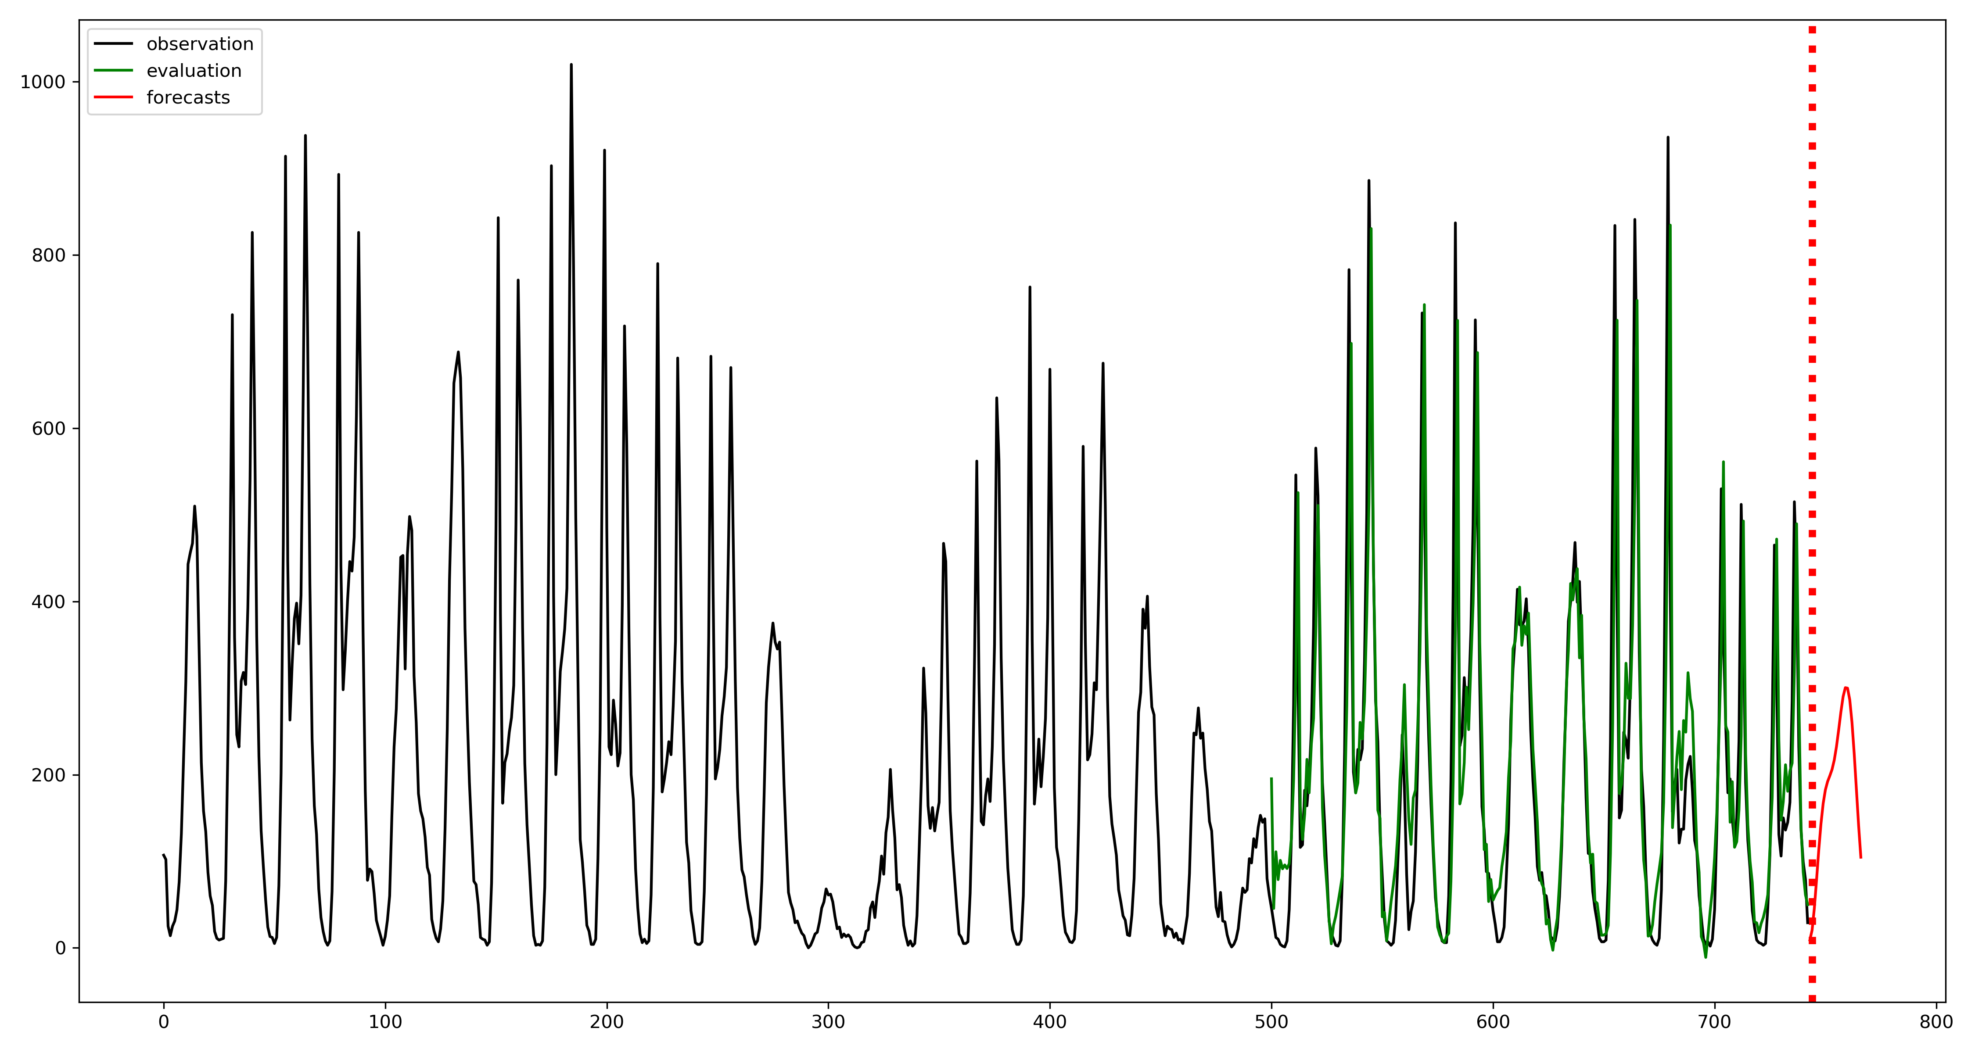
Results for the two Methods
Estimating city bike needs in January, 2019. (Time-step=1h)
Method | MAE | MSE | RMSE
ARIMA(1,0,1) | 112.9 | 15076.8 | 122.8
LSTM | 74.6 | 11578.6 | 107.6
ARIMA
One-step LSTM

Slide 7
Dual-Attention Mechanism for Predicting Shared Bike Needs
$$u_{1, t−1}$$
Row-Stack
Need for station 1 from $t−T$ to $t−1$
$$u_{1, t−T}, …, u_{1,t−1}$$
Temporal Attention with LSTM
Soft-max
Spatial Attention with LSTM
Soft-max
$$x_{t−T}$$
$$y_{t−T}$$
LSTM
LSTM
$$u_{t−T}$$
$$u_{2, t−T}, …, u_{2,t−1}$$
Memory
$$u_{2, t−1}$$
…
…
$$x_{t−2}$$
$$y_{t−2}$$
$$u_{t−2}$$
LSTM
LSTM
…
$$x_{t−1}$$
$$y_{t−1}$$
$$u_{t−1}$$
$$u_{n, t−1}$$
LSTM
LSTM
$$u_{n, t−T}, …, u_{n,t−1}$$
$${\hat{y}}_{T}$$
Spatial Attention Encoding
Temporal Attention Encoding
Decoding

Slide 8
Comparing two methods
Predicting bike requirements at all stations, given 1-month data.
Method | MAE | MSE | RMSE
Multivariant LSTM | 0.731 | 1.513 | 1.230
DA-RNN | 0.406 | 0.625 | 0.791

Slide 9
一些困难 & future work
通过DA-RNN的地区转移预测：
由于站点较多，站点转移矩阵中包含大量0，直接使用DA-RNN在训练的过程中梯度会消失。
站点转移矩阵过大，算力不足，且输入长度序列增加会使性能迅速下降。
运用RL进行spatial transfer prediction.
Multivariant LSTM的问题：
我们所使用的Multivariant LSTM是通过直接并联多个LSTM以达到所需的目的，其忽略了站点之间bike need的相关性。
DA-RNN/other inspiring method.

Slide 10
Deep Reinforcement Learning
State Space:
The current bike number vector $c={\left(c_{1} c_{2}⋯c_{n}\right)}^{T}$ denoting the current number of bikes at each station.
The predicted bike usage vector $u={\left(u_{1} u_{2}⋯u_{n}\right)}^{T}$ denoting the predicted bike usage, returned by the prediction module.
State is denoted by $s={\left(c u\right)}^{T}∈𝒮$.
Action space:
For a station $x$, a vector $a_{x}={\left(a_{xy_{1}} a_{xy_{2}} ⋯ a_{xy_{n}}\right)}^{T}$ denoting transiting $a_{xy_{i}}$ bikes from station $x$ to station $y_{i}$.
The total action $a={\left(a_{1}^{T} a_{2}^{T}⋯a_{n}^{T}\right)}^{T}∈𝒜$ is the flattened vector combining the transition of each stations.
Reward:
Fixed reward $r=1$ for each time of use.
Without other rewards: maximize utilization.
$r<0$ for moving bikes, $r≤0$ for unsatisfied needs: maximize profit.

Slide 11
Deep Q-Learning
FCL*2
-> 512-dim vector
FCL
$$Q\left(a_{t}=1\right)$$
normalized
policy generator
$$\left({\hat{u}}_{t+1}, c_{t}\right)$$
…
$$P\left(a_{t}=i\right)$$
$ε$-greedy
$$Q\left(a_{t}=i\right)$$
$$a_{t}$$
$$a_{t}=i$$
Env

Slide 12
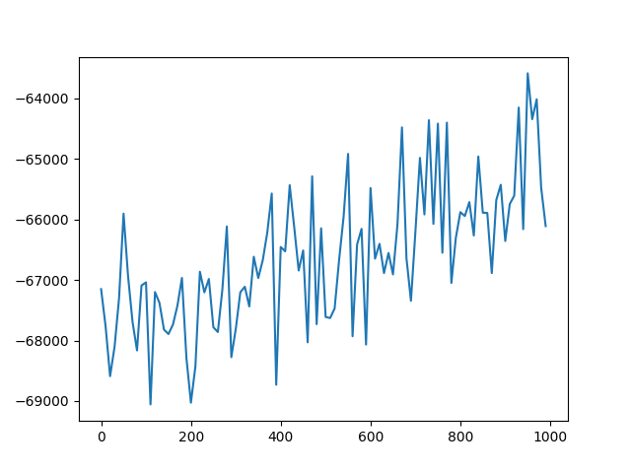
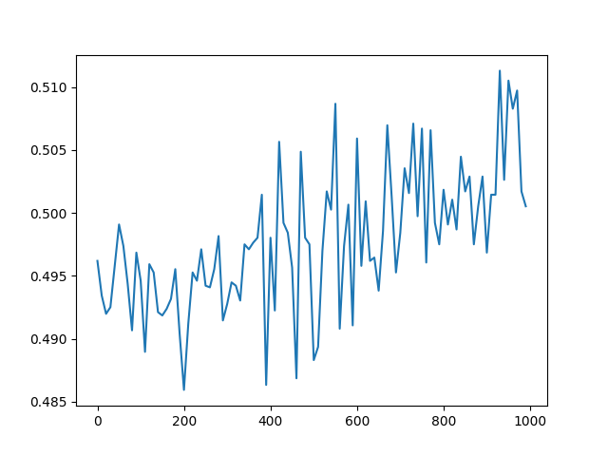
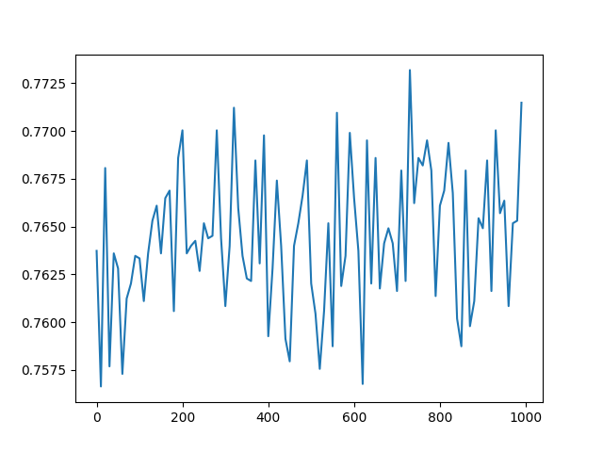
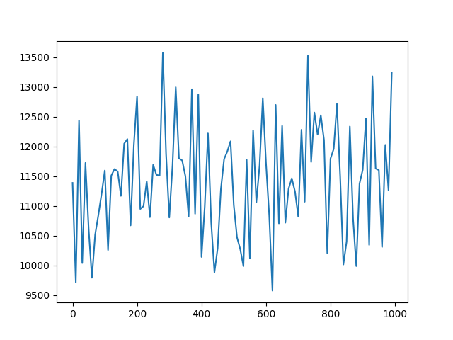
Experiment
Reward settings: -5 for each move, 1 for each use, -2 for each unsatisfied need
Experiment with randomly chosen 10 stations.
Reward with Time
Satisfied Percentage with Time
Satisfied Percentage with Time
Reward with Time
Start at 5 bikes/station.
Start at 10 bikes/station.

Slide 13
一些困难 & 可能的解决方案
收敛性问题：
Deep Q Learning 收敛较慢，当前的实验时间还未做到收敛。
Action Space 的规模问题：
Action Space的规模在$Ω\left(B^{n^{2}}\right)$ ，随站数二阶指数增长。
可以通过对station进行fully-cooperated multi-agent RL解决，这样可以将Action Space缩小到$Ω\left(nB^{n}\right)$. 但这种解决方案会提高对算力的要求，以及使收敛变得更慢。

