Slide 1
How to extract information you want?
Qianru Li (李倩茹)
Notes:
Today let’s talk about…

Slide 2
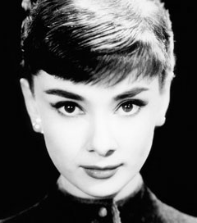
What makes her gorgeous?
model
Foreground
data
Background
data
Difference
Obvious, but rubbish ☹
Notes:
Consider this example, there are many beautiful ladies, such like Hepburn, and we wonder what features make them so gorgeous?
Generally, we may collect the facial information of many beautiful ladies and learn the information to generate a model. We ask, model, model, how does a beautiful lady look like?
Unfortunately, the model may answer, the beautiful lady mush have two eyes, a mouth and hair, she looks like that.
See, although the results are obvious, they are useless. Because such features are common to all human being, not specific to beautiful ladies.
If we call the data we care about, such as beautiful ladies in this example, foreground data; and call the human being background data. To get the features specific to foreground data, we must understand the difference between them.

Slide 3
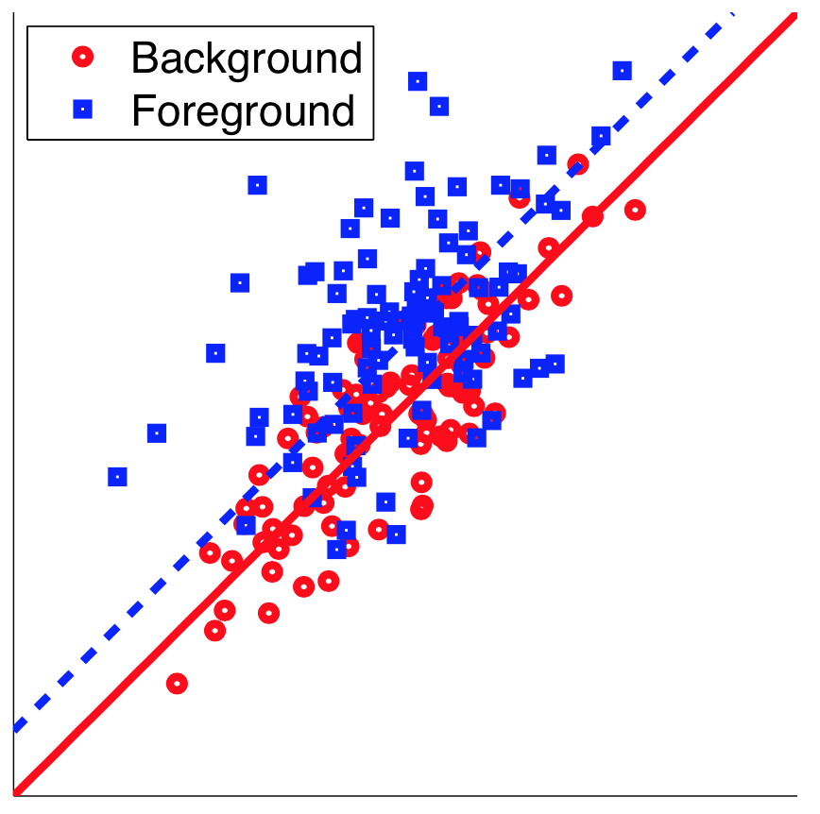
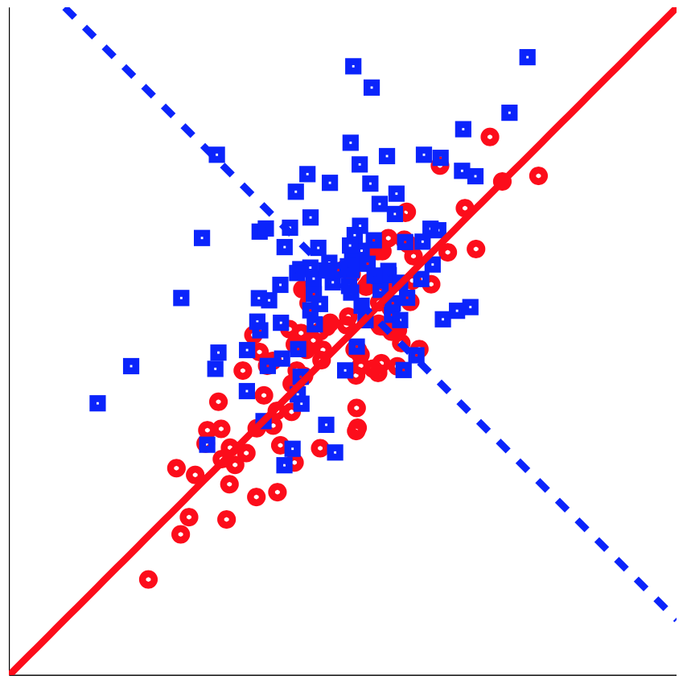
Which one better represents the difference
Notes:
Linear regression:
Model: a line

Slide 4
Model and Mixture Model
Model
Learn
Raw data
Generate
weight
Single model:
Mixture model:

Slide 5
Model and Mixture Model
Model
Learn
Dataset
Generate
Notes:
Let me introduce a bit knowledge about models.
Model: generation process, generate each sample, determines how data probably look like
In a more complicated situation, Mixture model consists of several sub-models: to generate a sample, first randomly choose a model according to a certain distribution, and then generate this sample according to this chosen model

Slide 6
Model and Mixture Model
Foreground models {1,2,3}
+ Neutral model {4}
Background models {5,6,7}
+ Neutral model {4}
Target: foreground model ——
Notes:
Because we have two dataset, foreground and background, there are two mixture models to generate them respectively.
Look at the components each mixture model, we assume these three sub-models as foreground-specific, they will only be chosen to generate foreground sample. Plus, there is a neutral model, which can generate both foreground and background data.
Similarly, we have background-specific models.
Now, the difference between foreground and background is model one to three. And our target is to learn the foreground specific model, learn weight and parameters

Slide 7
Method of Moments
Solve the equations
Notes:
How to estimate the parameter? The criterion is method of moments
Probability distribution: given type, unknown parameters
Then, we calculate the theoretical expectation of random variable to one-order, two-order, until n-order. And in this case, you can just regard the terminology moment of such expectation. Then, we get n function of \mu along with its value. By solving all the equations, we get \mu.

Slide 8
Topic model: document analysis
Foreground
Models
Neutral
Models
Background
Models
Computer science
Irrelevant documents
Notes:
Now, we apply those tools to analyze documents. For example, with paper for computer science field, we want to extract prevailing topic, advanced algorithm, etc.
We don’t want any information about English grammar or syntax structure shared by all documents. Therefore, we introduce background data, maybe English essays from some magazines.
There are three kinds of sub-models mixed together to generate foreground documents and background documents.

Slide 9
Topic model: document analysis
Corpus(文集)
Document
Word
Mixture model
A model
Word distribution
Notes:
Again, it’s the generation process of a corpus.
Choose a model according to the multinomial distribution of w
With the determined model, we assume it as a dirichlet distribution to generate the word distribution
Then, we try to estimate parameters for the foreground models

Slide 10
Topic model: document analysis
Corpus
Document
Word
Mixture model
A model
A sample
Generate a document:
Choose a model M from mixture model:
Generate each word X:

Slide 11
Topic model: document analysis
Word:
Index | Vocabulary | Word
1 | a | 0
2 | ab | 0
3 | aba | 0
… | … | 0
j | computer | 1
j+1 | computing | 0
… | … | 0

Slide 12
Moment construction
Document: I love you.
Generated by model j
Variable of different order | Statistic samples | Expectation
One word | I,love, you
Two word (pair) | (I,love);(I,you); (I, I);(love,you);(love,love);(you,you)
Three word (triple) | (I,love,you);(I,l,I); (I,I,you);(l,I,love);(you,you,you);……

Slide 13
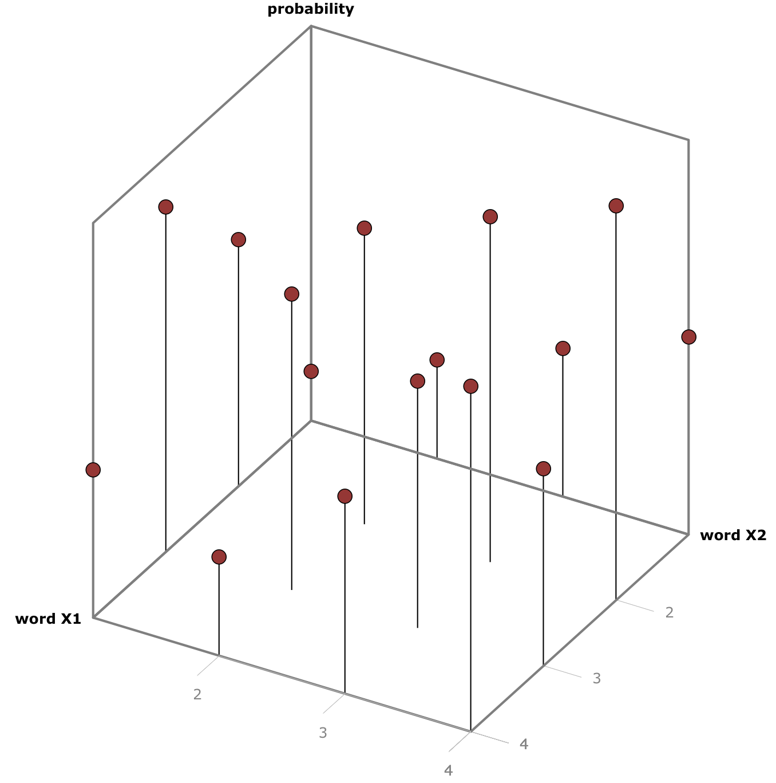
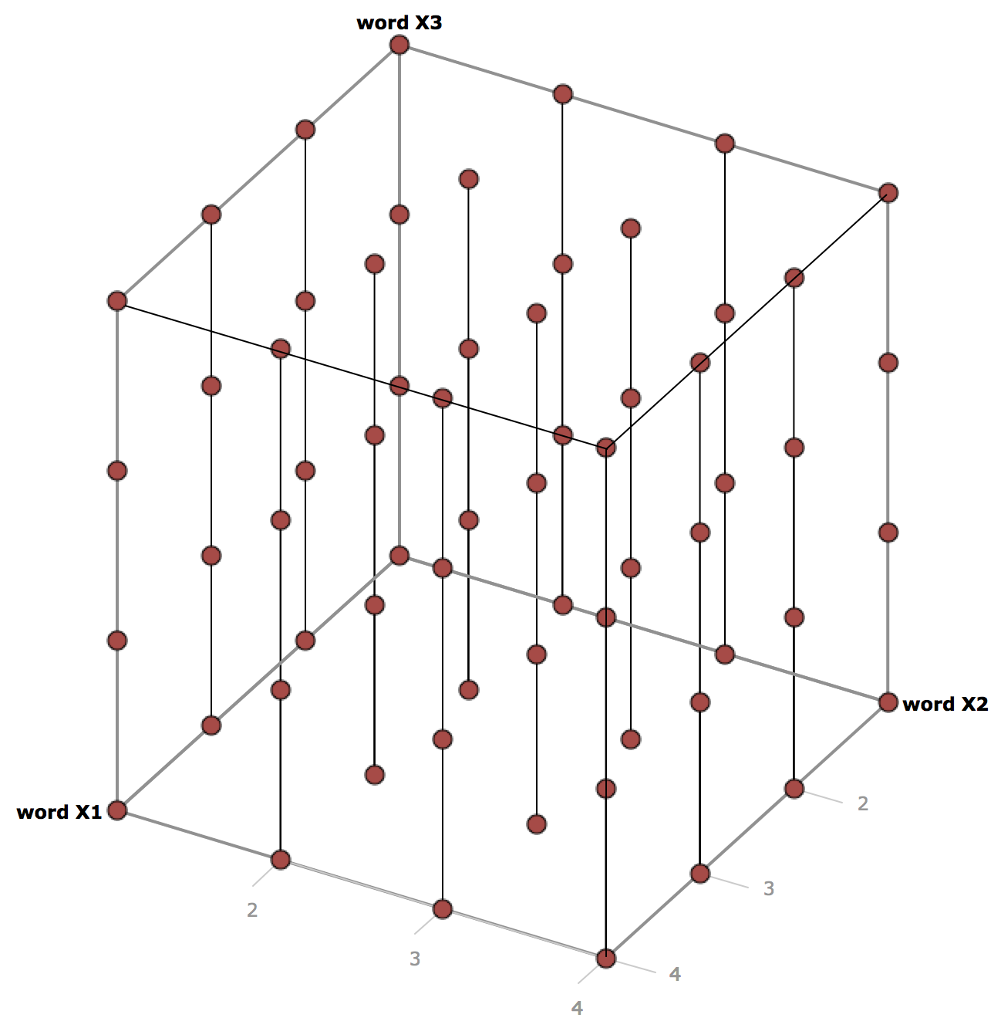
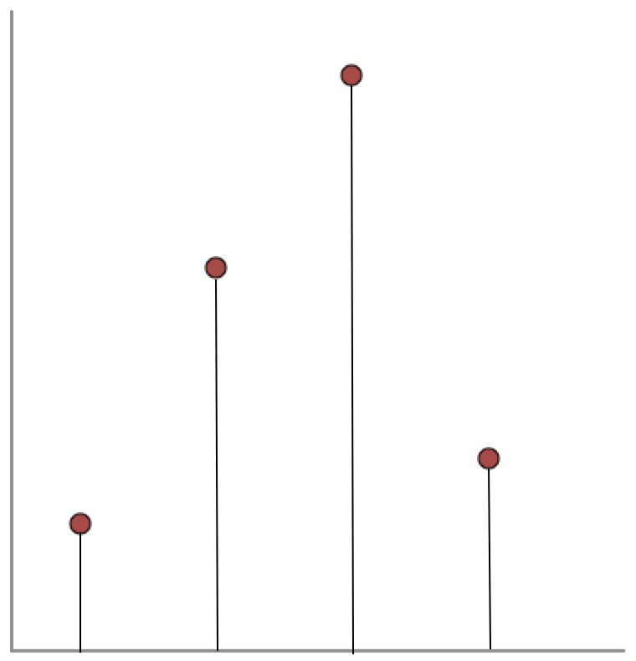
Moment construction
One-order Moment
Two-order Moment
Three-order Moment

Slide 14
Moment Construction
One-order Moment
Two-order Moment
Three-order Moment
Notes:
Now, what’s the meaning of moment to different order?
For one-order moment, it’s the probability of one word in the document
For two-order moment, it’s the probability of a pair of words
For three-order moment, it’s the probability of a triplet of words

Slide 15
Moment Construction
Notes:
Then, by mathematical deduction and linear computation between moments, we get such uniform structure.
And we denote such expressions as M1,M2,M3 value for each sub-model.

Slide 16
Moment Construction
Moment of one model: j | Moment of mixture model
weight
model
Notes:
For mixture mixture model, M1,M2,M3 is composed of each sub-model’s results and this figure illustrates the composition of M in mixture model

Slide 17
Eliminate background models
Foreground models
Neutral models
Background models
Foreground moment
Background
moment
Foreground - Background
Notes:
If this represents foreground mixture model, the M value for background mixture model share the same structure.
From these figures, we can find these two are foreground-specific models because these weight are nearly zero for background data. Similarly, these models are neutral, and others are background specific.
Then, if we subtract background information from foreground, the result may look like this:

Slide 18
Eliminate background models
Foreground moment
Background
moment
Foreground -Background
Foreground models
Neutral models
Background models
Notes:
Moment subtraction means eliminating background models

Slide 19
Eliminate background models
Foreground models ←→ models with positive weight!
How to obtain parameters for those models?
Notes:
And only foreground components have positive coefficient， while others are negative.
Therefore, to get foreground-specific models, we only need to pick out all components with positive coefficient. How to do that?

Slide 20
Parameter estimation
+
… +
+
… +
Tensor decomposition
Notes:
Let’s look at the structure: M2 is a matrix, and this is eigenvalue decomposition
In more general case with higher order, M3 is 3-order matrix, called tensor. And this tensor has similar structure, we apply tensor decomposition.

Slide 21
Parameter estimation
HOSVD: Reduce dimension
Tensor transformation: Orthogonality guarantee

Slide 22
Parameter estimation
Inner-loop:
Convergence:
Notes:
A glance at the algorithm

Slide 23
Parameter estimation
Why tensor decomposition ?
 | EM algorithm | Tensor decomposition
Convergence Guarantee | Local optimum | Global optimum
 | Very slow | Exponential speed
Computational Complexity | Many iterations | Less iterations
 | High especially for high-dimension | O(KD)

Slide 24
Thank you

