Slide 1
COMP 110-001 Programming Basics
Yi Hong
May 14, 2015

Slide 2
Announcements
The slides of the previous two lectures have been updated on the course website
There are seven custom textbooks available in the university book store, we can order more if needed

Slide 3
Review
Binary to decimal conversion
10110
Is Java a high-level language or a low-level language?
How is “Write once, run everywhere” achieved in Java?
What’s output of the following Java statement?
System.out.println(“Java is great!”);
Notes:
22

Slide 4
Today
Object-Oriented Programming (OOP)
Intro to encapsulation, polymorphism, and inheritance
Writing algorithms in pseudocode
Variables, arguments, statements, and syntax

Slide 5
Object-Oriented Programming
Our world is made up of objects, e.g., people, buildings, trees, cars, cabbages
Objects can perform actions, which affect themselves and other objects in the world
Object-oriented programming (OOP) treats a program as a collection of objects that interact by means of actions

Slide 6
OOP Terminology
Objects: have attributes and behaviors
Methods: each behavior is called a method
Class: Objects of the same kind have the same type and belong to the same class
Objects within a class have a common set of methods and the same kinds of data
But each object can have its own data values
An example: students in this class
Attributes: name, age, major, hobbies …
Actions: talk, submit assignment, play games …

Slide 7
Why OOP?
When we build a large system, we usually divide the whole system into small pieces
Uses objects as building blocks and “object interaction” in programming
Each object only cares about the interactions with them
An example: this lecture
Objects: instructor, students …
Object interaction: discuss, submit assignments …

Slide 8
OOP Design Principles
Three primary design principles
Encapsulation
Polymorphism
Inheritance

Slide 9
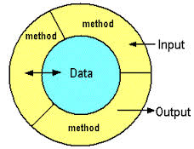
Encapsulation
Packages things up and hides details
Provides how to use a class, but omits all the details of how it works
Encapsulation is often called information hiding

Slide 10
An Example
An automobile consists of several parts and is capable of doing many useful things
Awareness of the accelerator pedal, the brake pedal, and the steering wheel is important to the driver
Hiding information: awareness of the fuel injectors, the automatic braking control system, the power steering pump is NOT important to the driver.

Slide 11
Polymorphism
“many forms”
Allows the same program instruction to mean different things in different contexts
Example: “Go play your favorite sport”
To one person, it means to play baseball
To another person, it means to play soccer
In programming, polymorphism means that one method name, used as an instruction, can cause different actions
More details in Chapter 8
Notes:
Method overloading
Method overriding

Slide 12
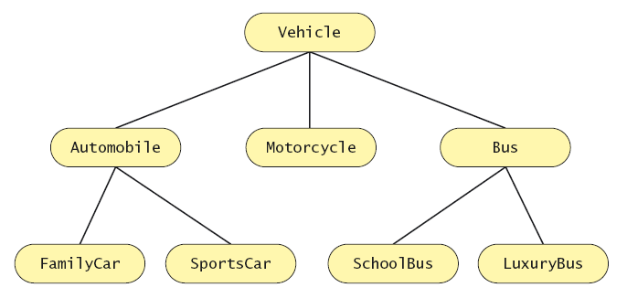
Inheritance
A way of organizing related classes
At each level, the classifications become more specialized

Slide 13
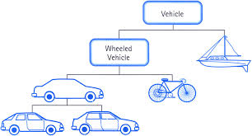
More About Inheritance
A class at higher level is more general
A class at lower level is more specific, and it inherits all the characteristics of classes above it in the hierarchy

Slide 14
Algorithm
A set of instructions for solving a problem
The directions must be expressed completely and precisely
By designing methods, programmers provide actions for objects to perform
In this course, we mainly consider a sequence of instructions in a method (one action)

Slide 15
Pseudocode
Before translating algorithm into code
A mixture of English and Java
Write each part of an algorithm in whatever language is easiest for you
An example:
For each student A in the class:
If A’s score > 60 Print A + “has passed”
Else Print A + “has Failed”

Slide 16
Vocabulary
Variables: store a piece of data. Think a variable as a container
Statements: instructions, the smallest standalone element of a programming languages
Syntax: grammar rules for a language
Arguments: information that methods need to carry out its action

Slide 17
Variables
int age;
age = 16;
A variable is a program component used to store or represent data
The data currently in a variable is its value
Name of variable is an identifier
Can change value throughout program
Choose meaningful variable names!!!

Slide 18
Variables and Memory
A variable corresponds to a location in memory
Variable: int age
Use this cell to store the value of the variable “age”
Prevent this cell from being used by other variables later
Bytes
11110000
11101001
00101010
10110101
01000101
main memory

Slide 19
Variable Declarations
Syntax
Type variable_1, variable_2, … ;
Examples
int count, score, myInt;
double totalCost, ratio;
char letter, answer;
We will discuss the data types in Java in the next lecture

Slide 20
How to Use Variables
Declare a variable
int age;
Assign a value to the variable
age = 16;
Change the value of the variable
age = age + 1;

Slide 21
How to Name an Identifier
Letters, digits (0-9), the underscore character (_)
The symbol $ is also allowed, but it is reserved for special purposes, so you should not use $ in a Java name
First character cannot be a digit
No spaces
Java is case sensitive
Legal identifiers: pinkFloyd, b3Atlas, eyeColor
Illegal identifiers: michael.bolton, kenny-G, 1CP

Slide 22
Keywords
Reserved words with predefined meanings
You cannot name your variables using keywords
All Java keywords are entirely in lowercase
We will learn them as we go along
E.g.: if, else, return, new, public, class, static, void …

Slide 23
Next class
Primitive type
Class type

